Slide 1
https://docs.nvidia.com/cuda/cuda-c-programming-guide/index.html

Slide 2
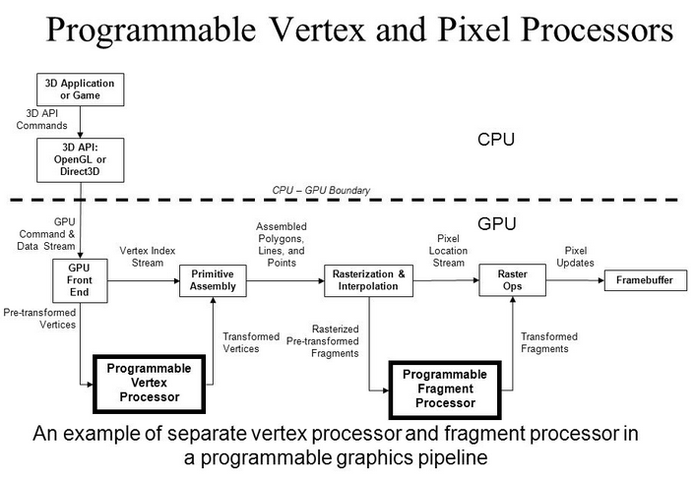
Evolution of Programmable Real time Graphics

Slide 3
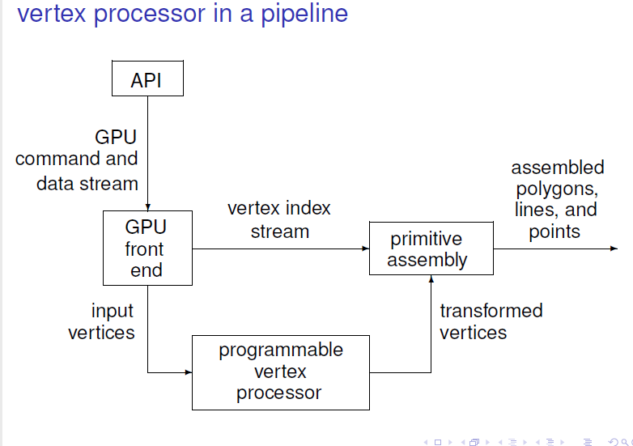

Slide 4
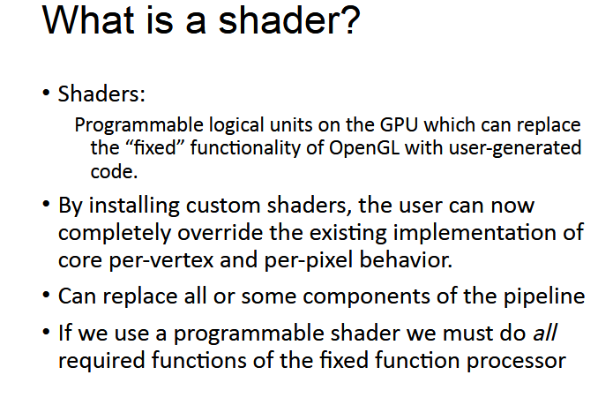

Slide 5
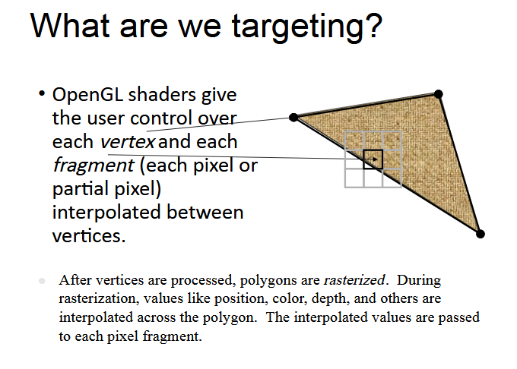

Slide 6
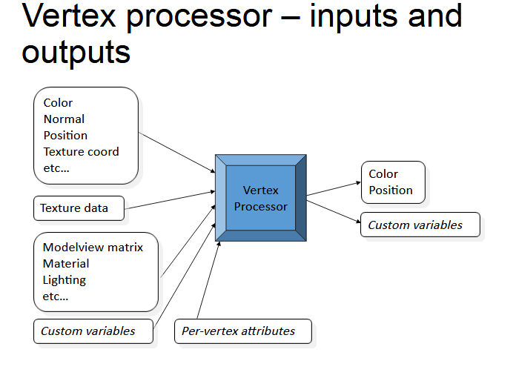

Slide 7
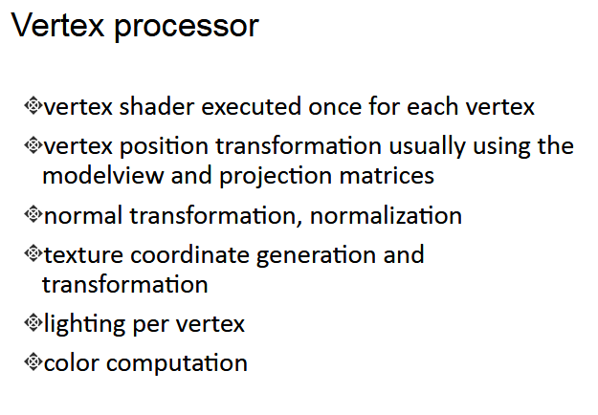

Slide 8
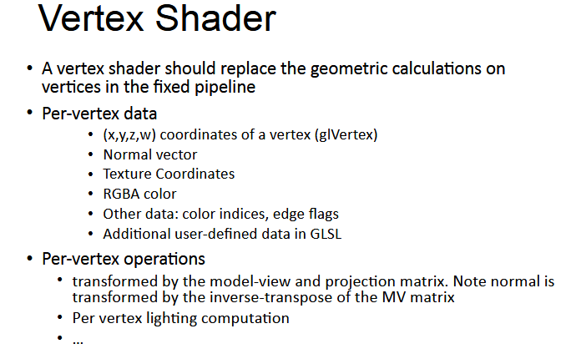

Slide 9
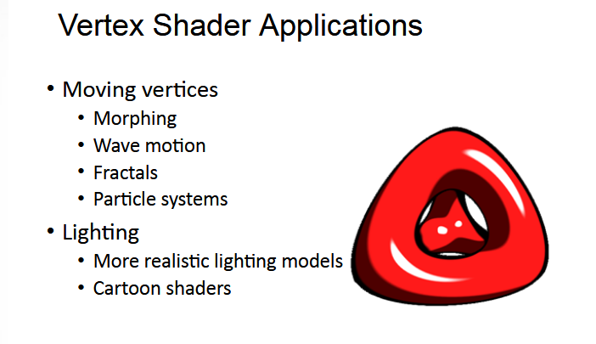

Slide 10
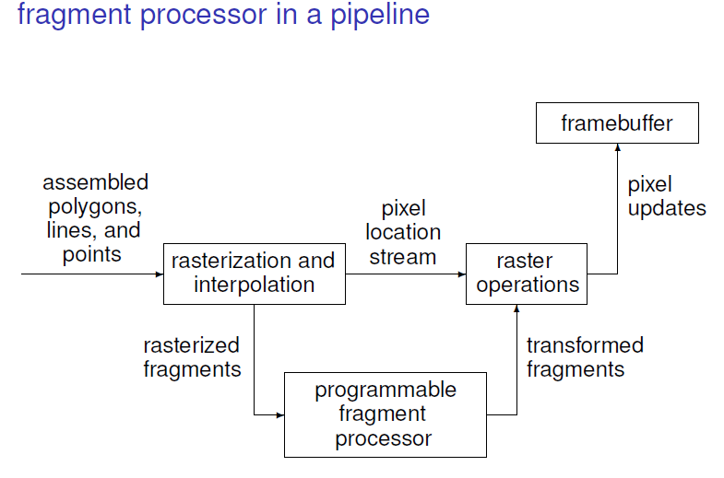

Slide 11
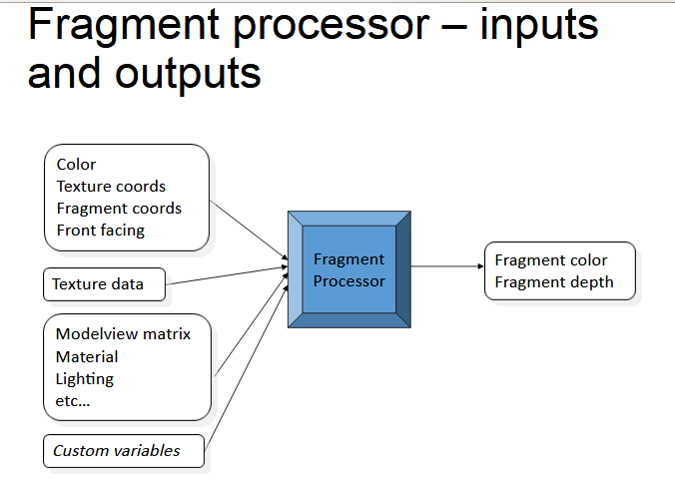

Slide 12
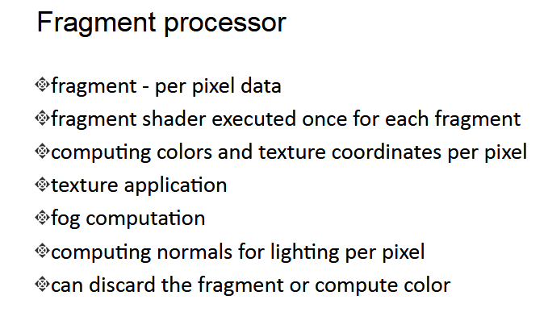

Slide 13
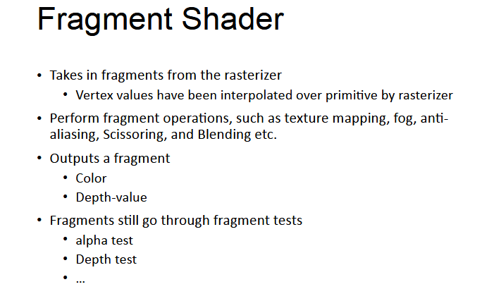

Slide 14
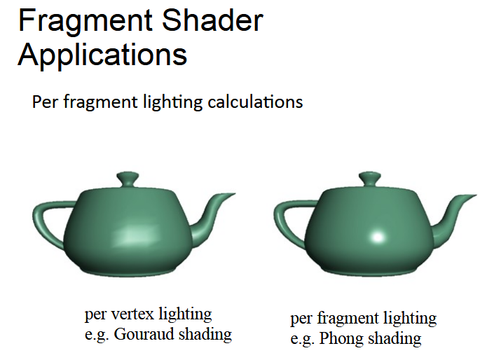

Slide 15
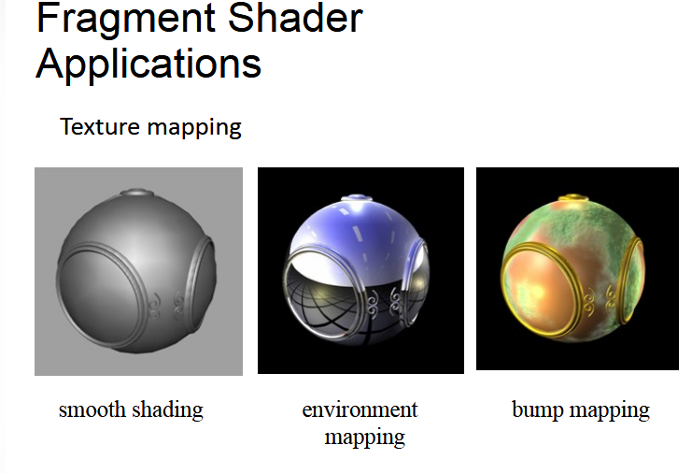

Slide 16
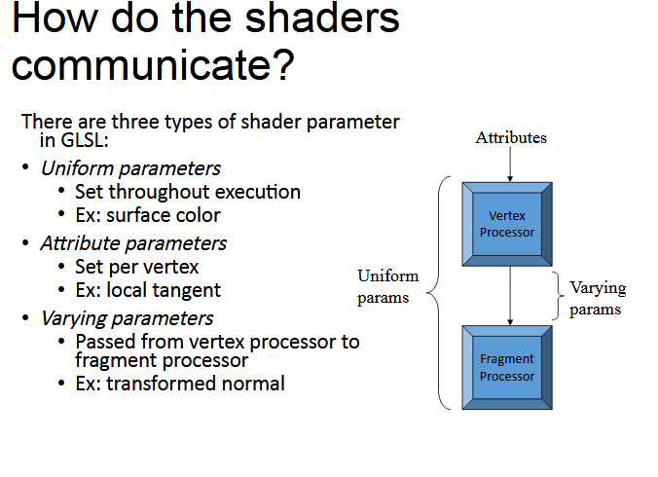

Slide 17
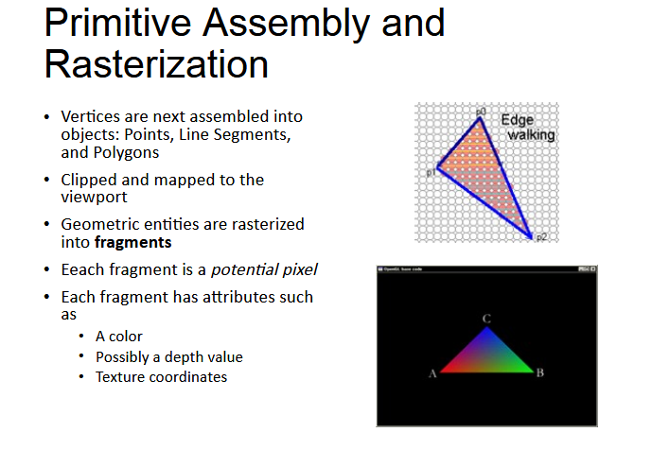

Slide 18
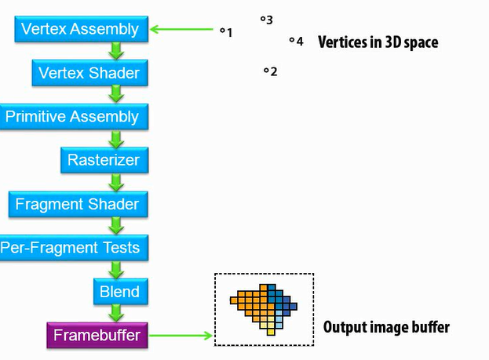

Slide 19
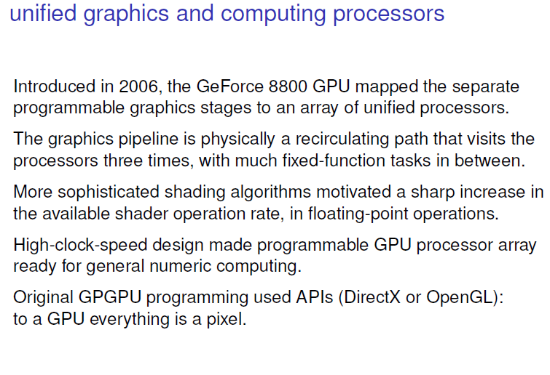

Slide 21
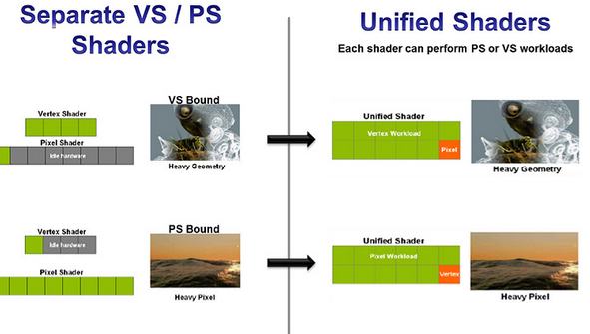

Slide 22
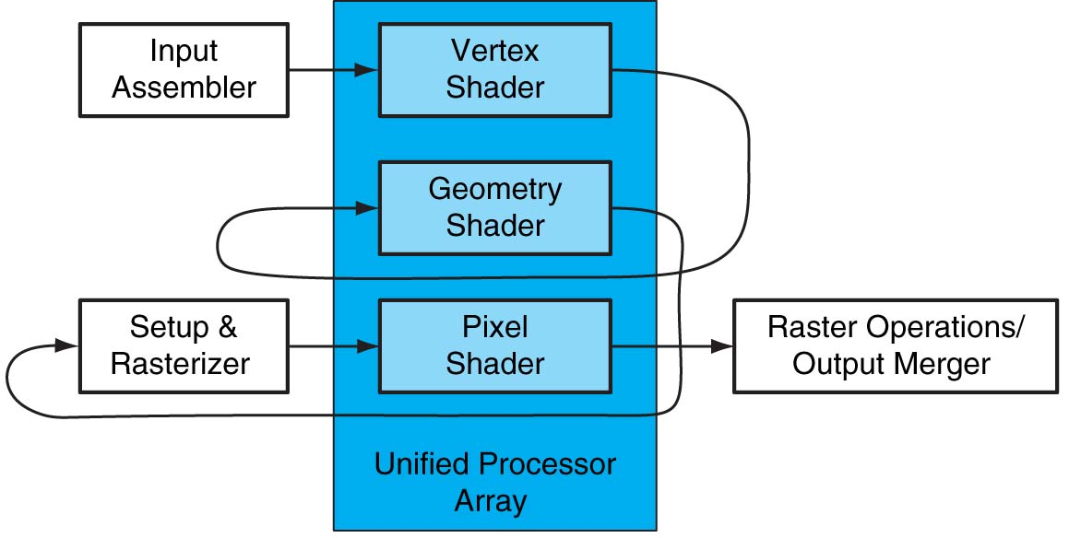
Basic Unified GPU Architecture
FIGURE A.2.4 Logical pipeline mapped to physical processors. The programmable shader stages execute on the array of unified processors, and the logical graphics pipeline dataflow recirculates through the processors. Copyright © 2009 Elsevier, Inc. All rights reserved.

Slide 23
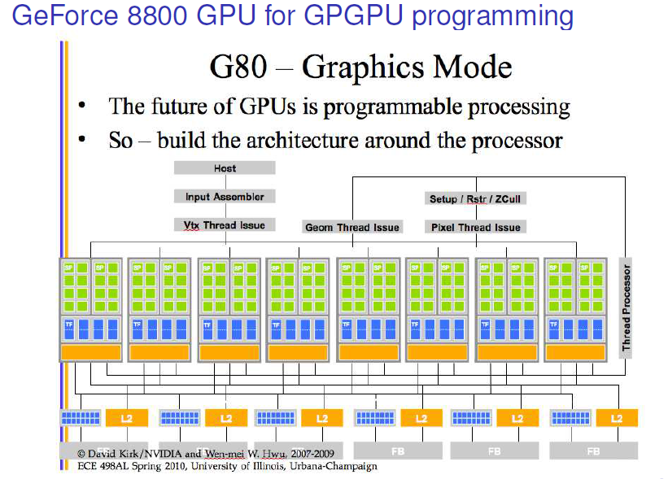
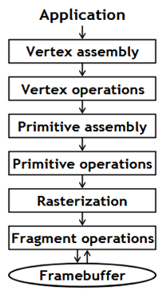
Unified programmable processor array of the Geforce 8800 GTX graphics pipeline

Slide 24
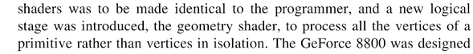
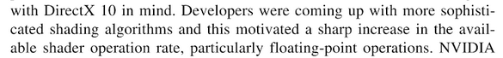
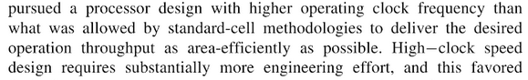
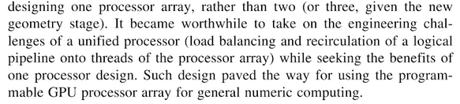

Slide 25
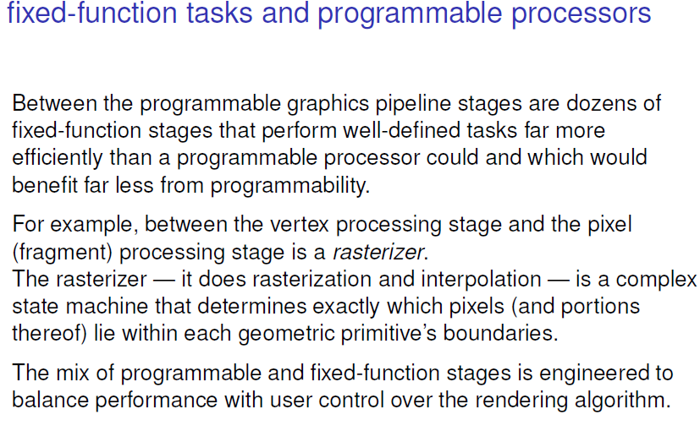

Slide 26
GPUs with a Unified Shader Architecture (all Nvidia products from G80 onwards) have two advantages over their fixed-function cousins.
First, they’re more efficient.
A fixed-function GPU’s performance can vary considerably from game to game depending on whether a title emphasizes pixel shading or model geometry; this is quite visible when comparing performance between Tegra 2/3 and the SGX 544.
A Kepler-based GPU would be much more flexible, able to allocate its execution resources to process either workload.
This can indirectly lead to decreased power usage — a wide array of more efficient stream processors doesn’t necessarily need to run at nearly as high a clock speed as a fixed-function chip.
Second, and arguably more important, is their ability to handle functions that would normally be processed on the CPU. This is where we expect T40 to come into its own

Slide 27
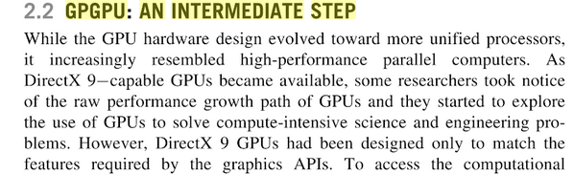
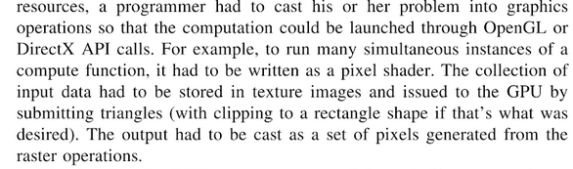

Slide 28
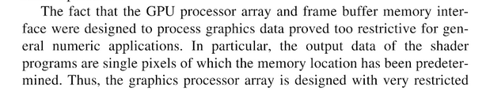
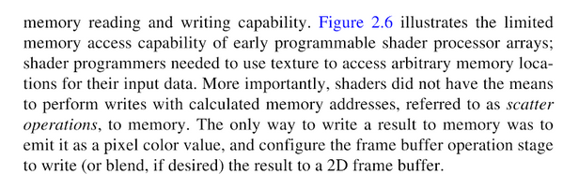

Slide 29
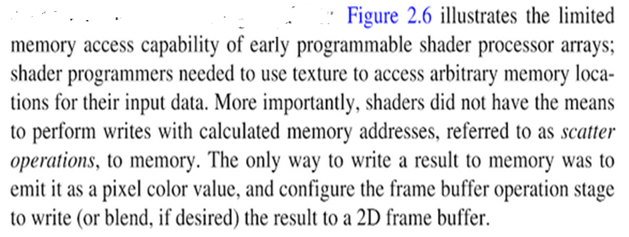
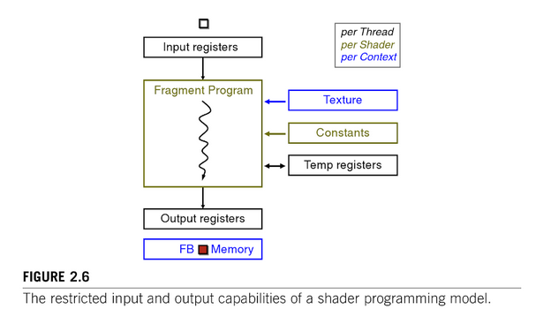

Slide 30
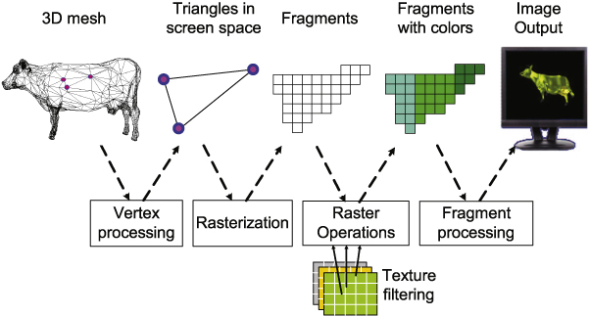

Slide 31
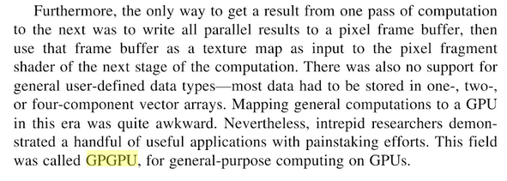

Slide 33
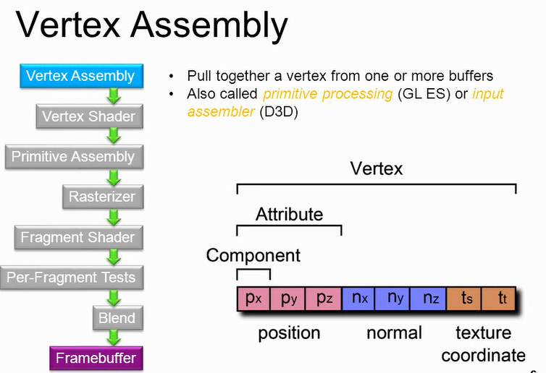

Slide 34
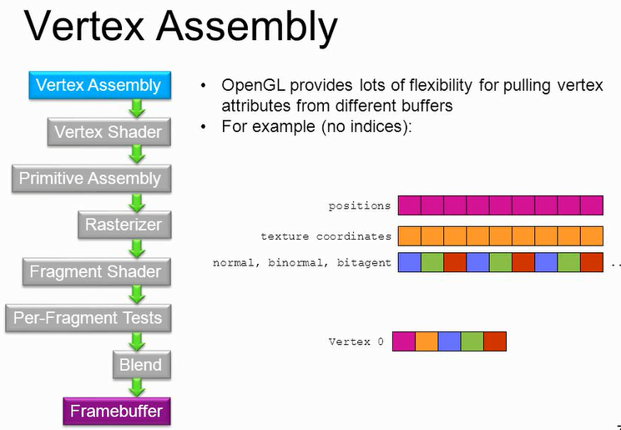

Slide 35
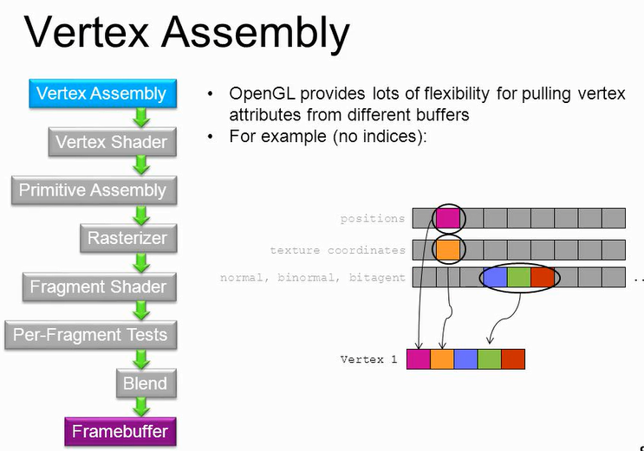

Slide 36
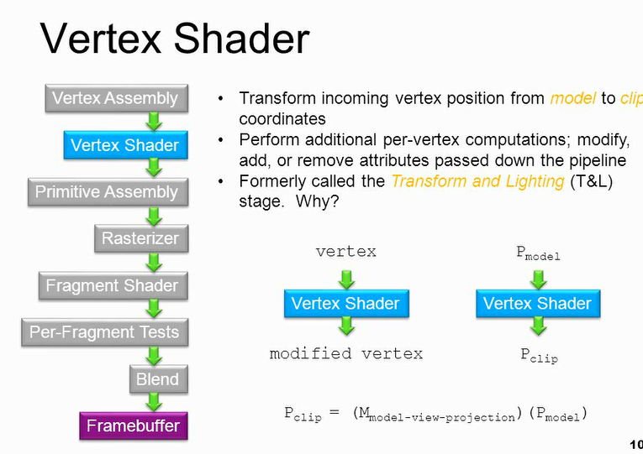

Slide 37
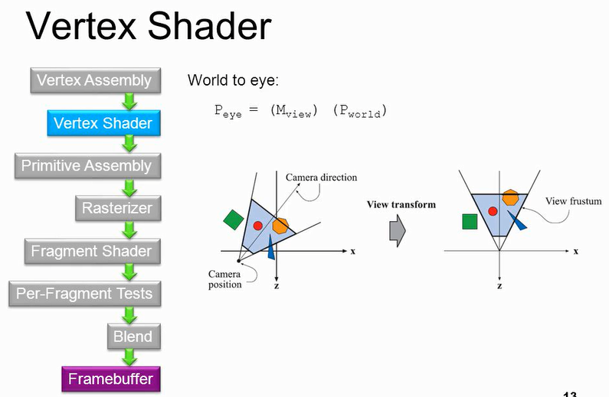

Slide 38
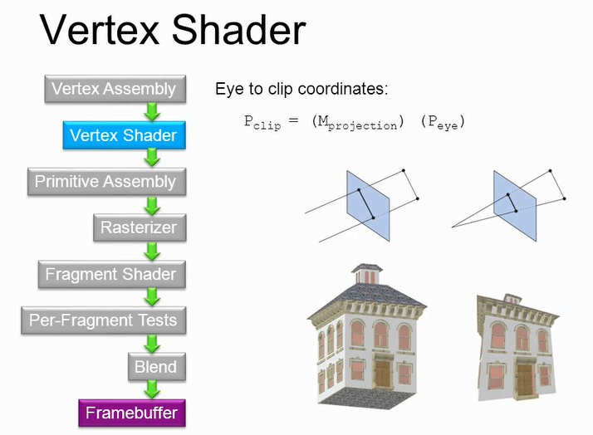

Slide 39
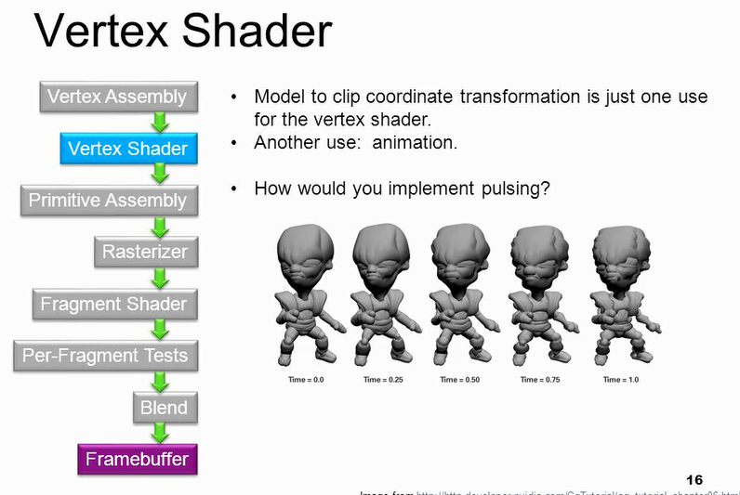

Slide 40
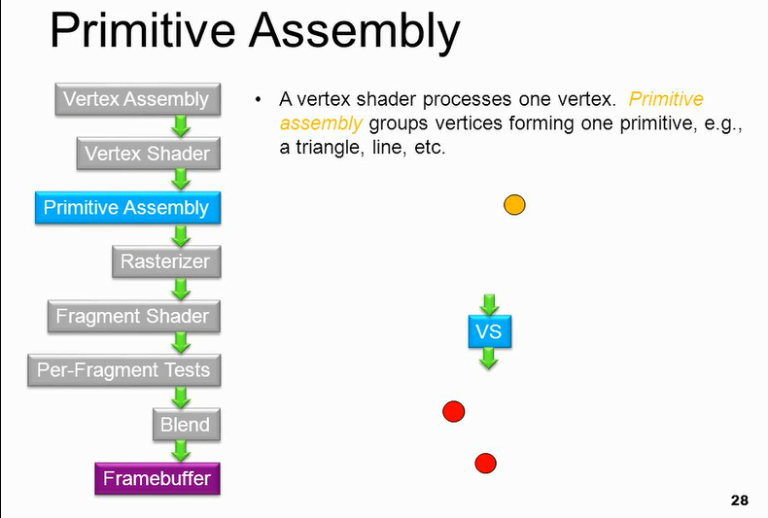

Slide 41
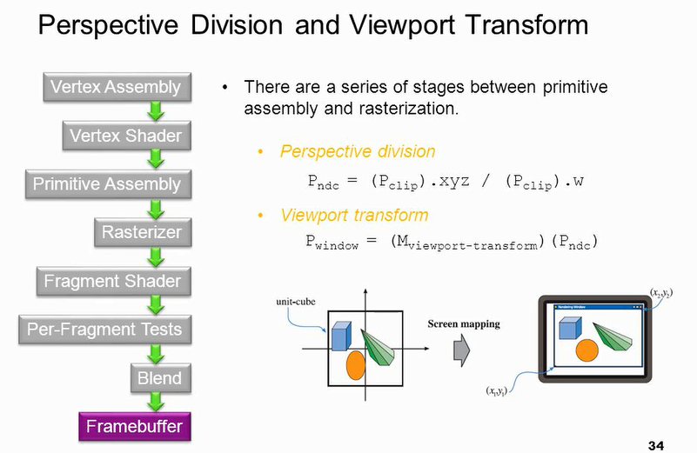

Slide 42
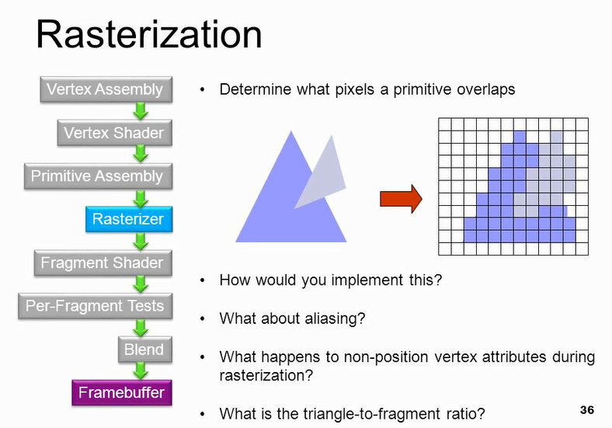

Slide 43
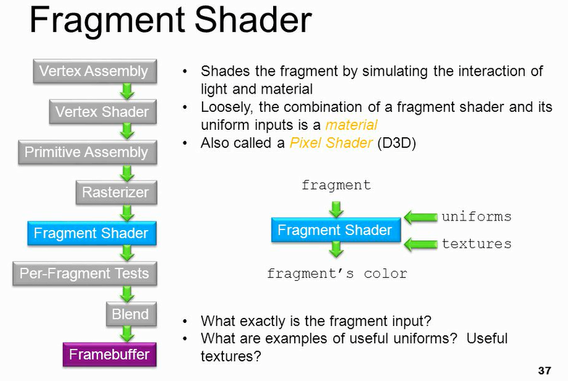

Slide 44
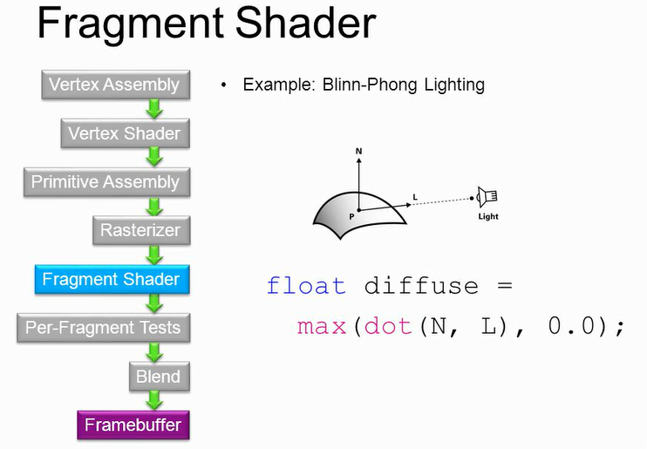

Slide 45
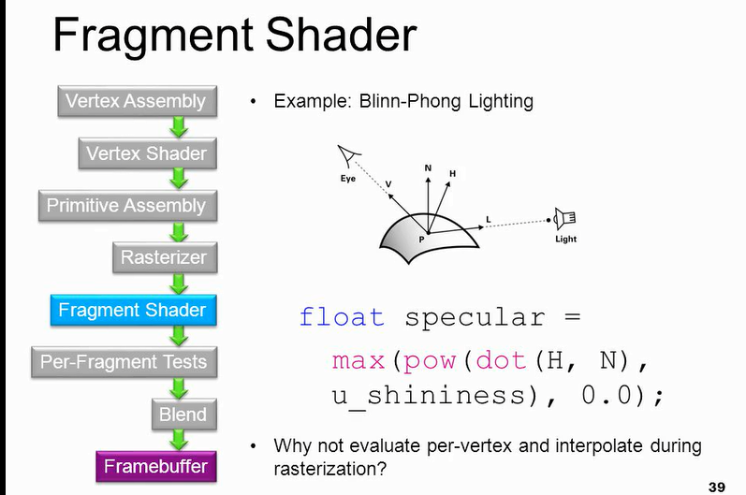

Slide 46
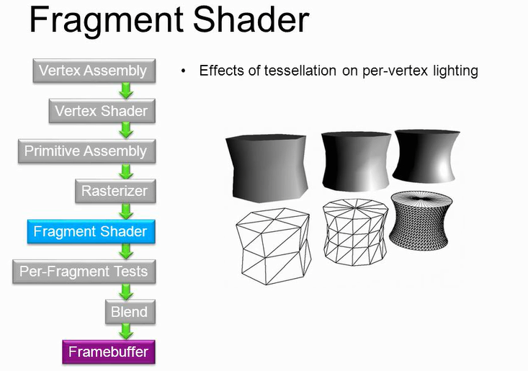

Slide 47
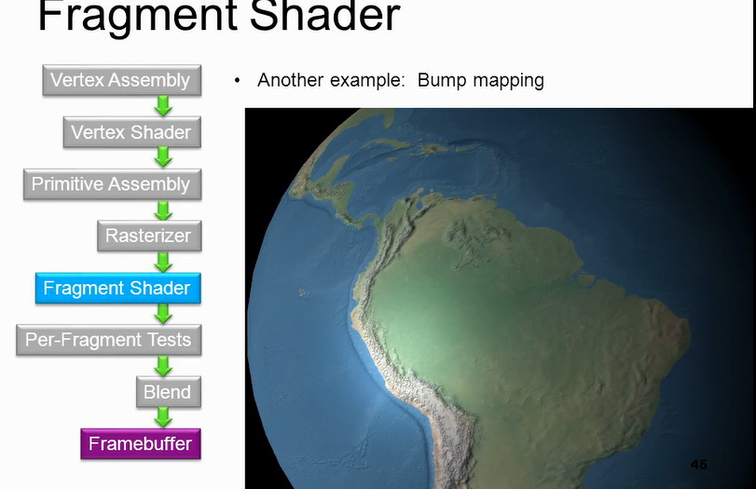

Slide 48


Slide 49


Slide 50


Slide 51


